Slide 1


Novel metrics and visualizations for gene and cell-type prevalence across single-cell studies
Team #1
Selen Manioğlu
Martina Scauda
Amir Khorashadizadeh
Antonio Santinha
Roche PMDA Summer School 2022

Slide 2





RNA-seq in drug discovery

Slide 3





Single-cell RNA-seq in drug discovery
scRNA-seq
scRNA-seq

Slide 4
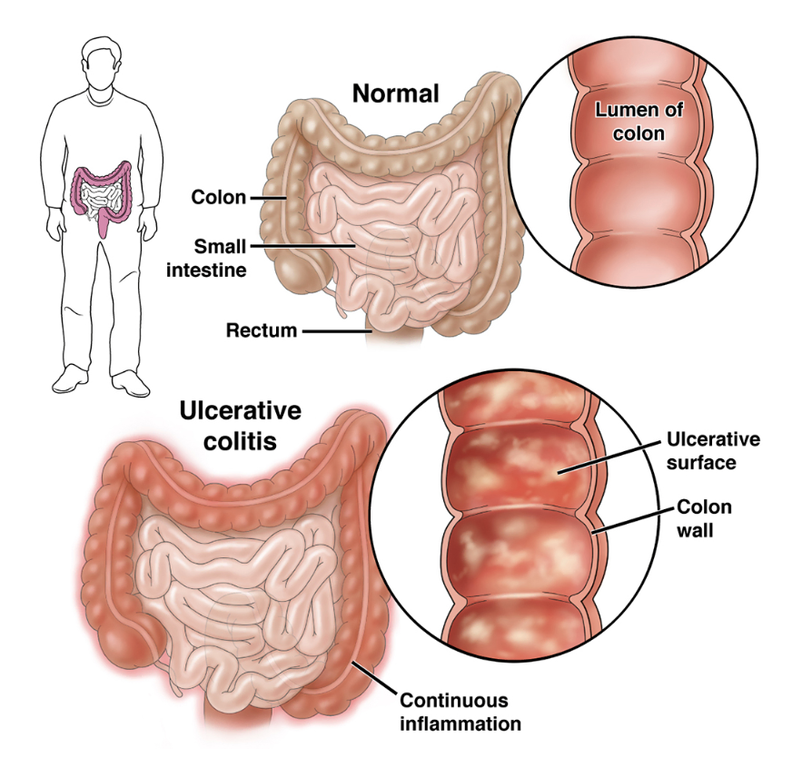
Human Colon Ulcerative Colitis
Inflammation and soring of the large intestine
Likely to appear in people between the ages of 15 and 30 years old
Treatments:
Control inflammation
Ease symptons
Fix nutrition deficiencies
Notes:
There are two main types of inflammatory bowel diseases — ulcerative colitis and Crohn’s disease. Ulcerative colitis is more common worldwide than Crohn’s disease.
It causes inflammation (swelling) and sores (called ulcers) in the large intestine (colon and rectum) and may affect part or all of the large intestine.
Ulcerative colitis can happen at any age, but it is more likely to develop in people between the ages of 15 and 30, or older than 60 years of age.
Ulcerative colitis needs to be diagnosed by a health care provider. While there are no cures, there are treatments.
The symptoms of ulcerative colitis can vary from person to person, based on where the disease is in the body and how bad the inflammation is.
Most common symptoms:
Diarrhea (loose stool), which is often the first symptom.
Blood in the stool.
Urgency, or immediate need, to go to the bathroom.
Increased number of bowel movements.
Belly pain and cramping.
The goals of treatment are to:
Control inflammation, or swelling.
Ease symptoms, like pain, diarrhea (loose stool) and bleeding.
Fix nutrition deficiencies, if needed.

Slide 5
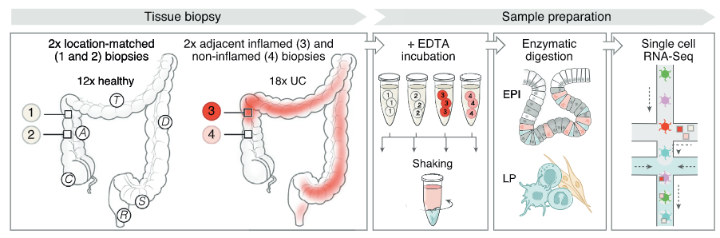
Colon Ulcerative Colitis dataset
Healthy donor
Colitis donor
Position 1
Position 2
Position 3
(inflamed)
Position 4
(non-inflamed)
CT 1
CT 2
CT 3
CT 4
…
CT 38

Slide 6
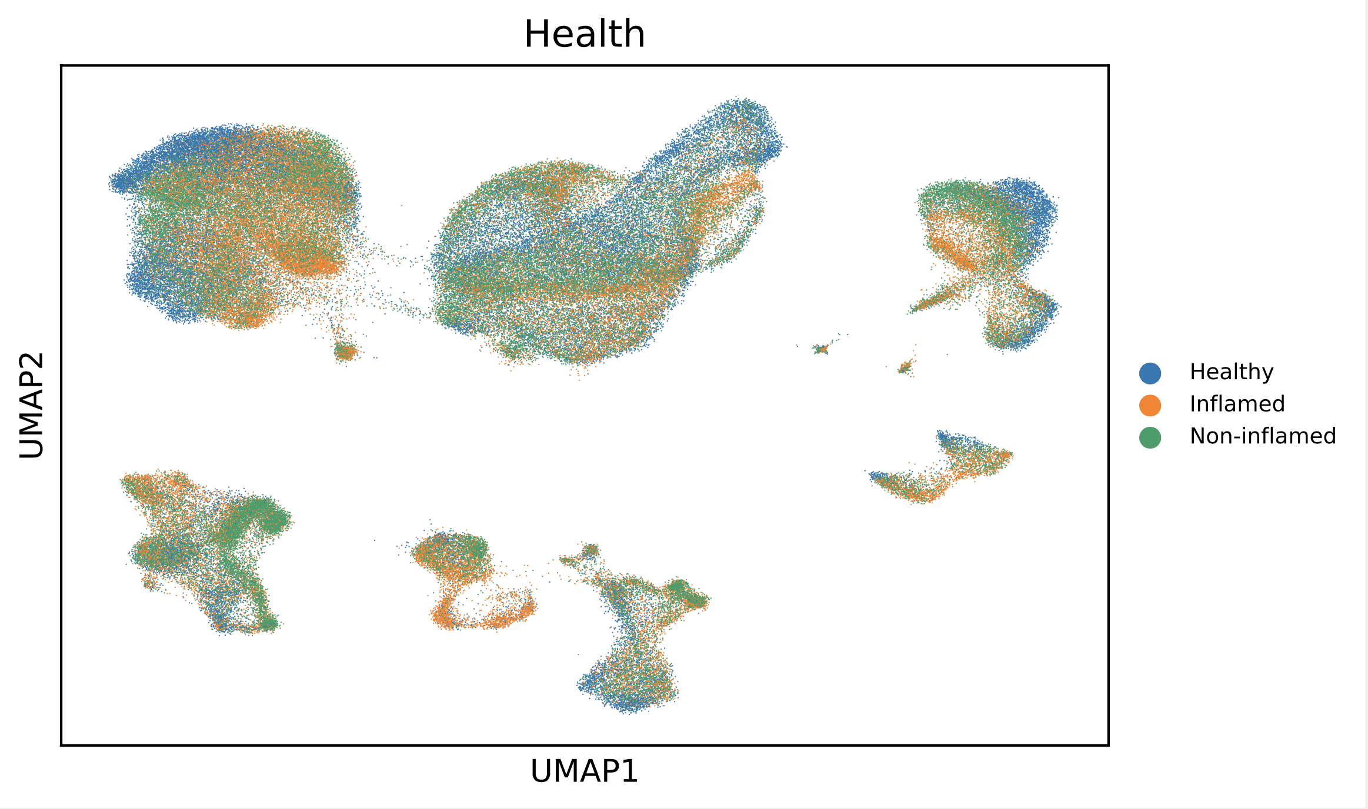
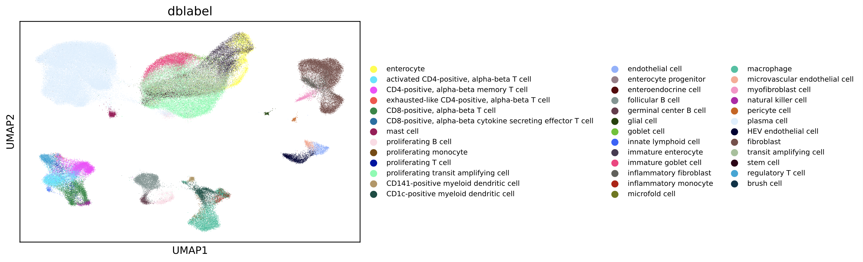
Which cell-typs are affected by the condition?
Health condition
Dblabel (cell type)

Slide 7
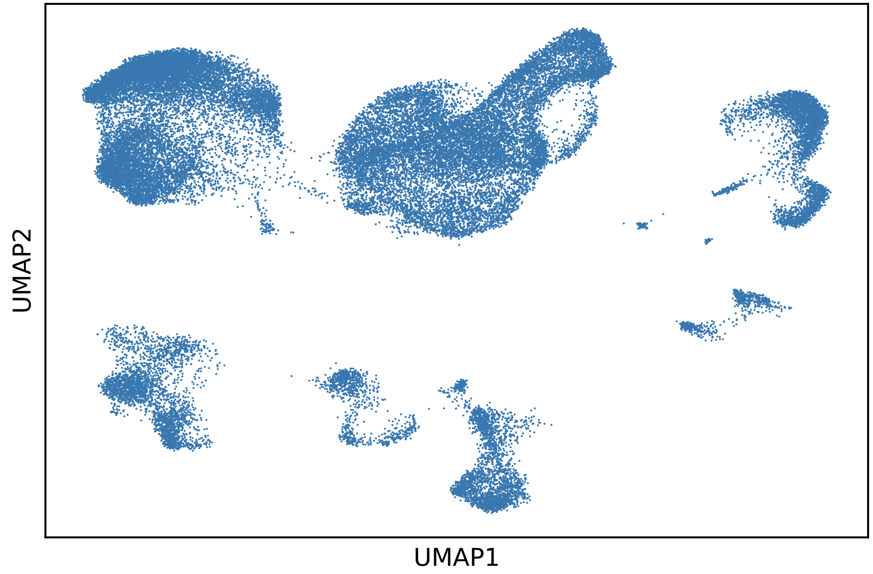
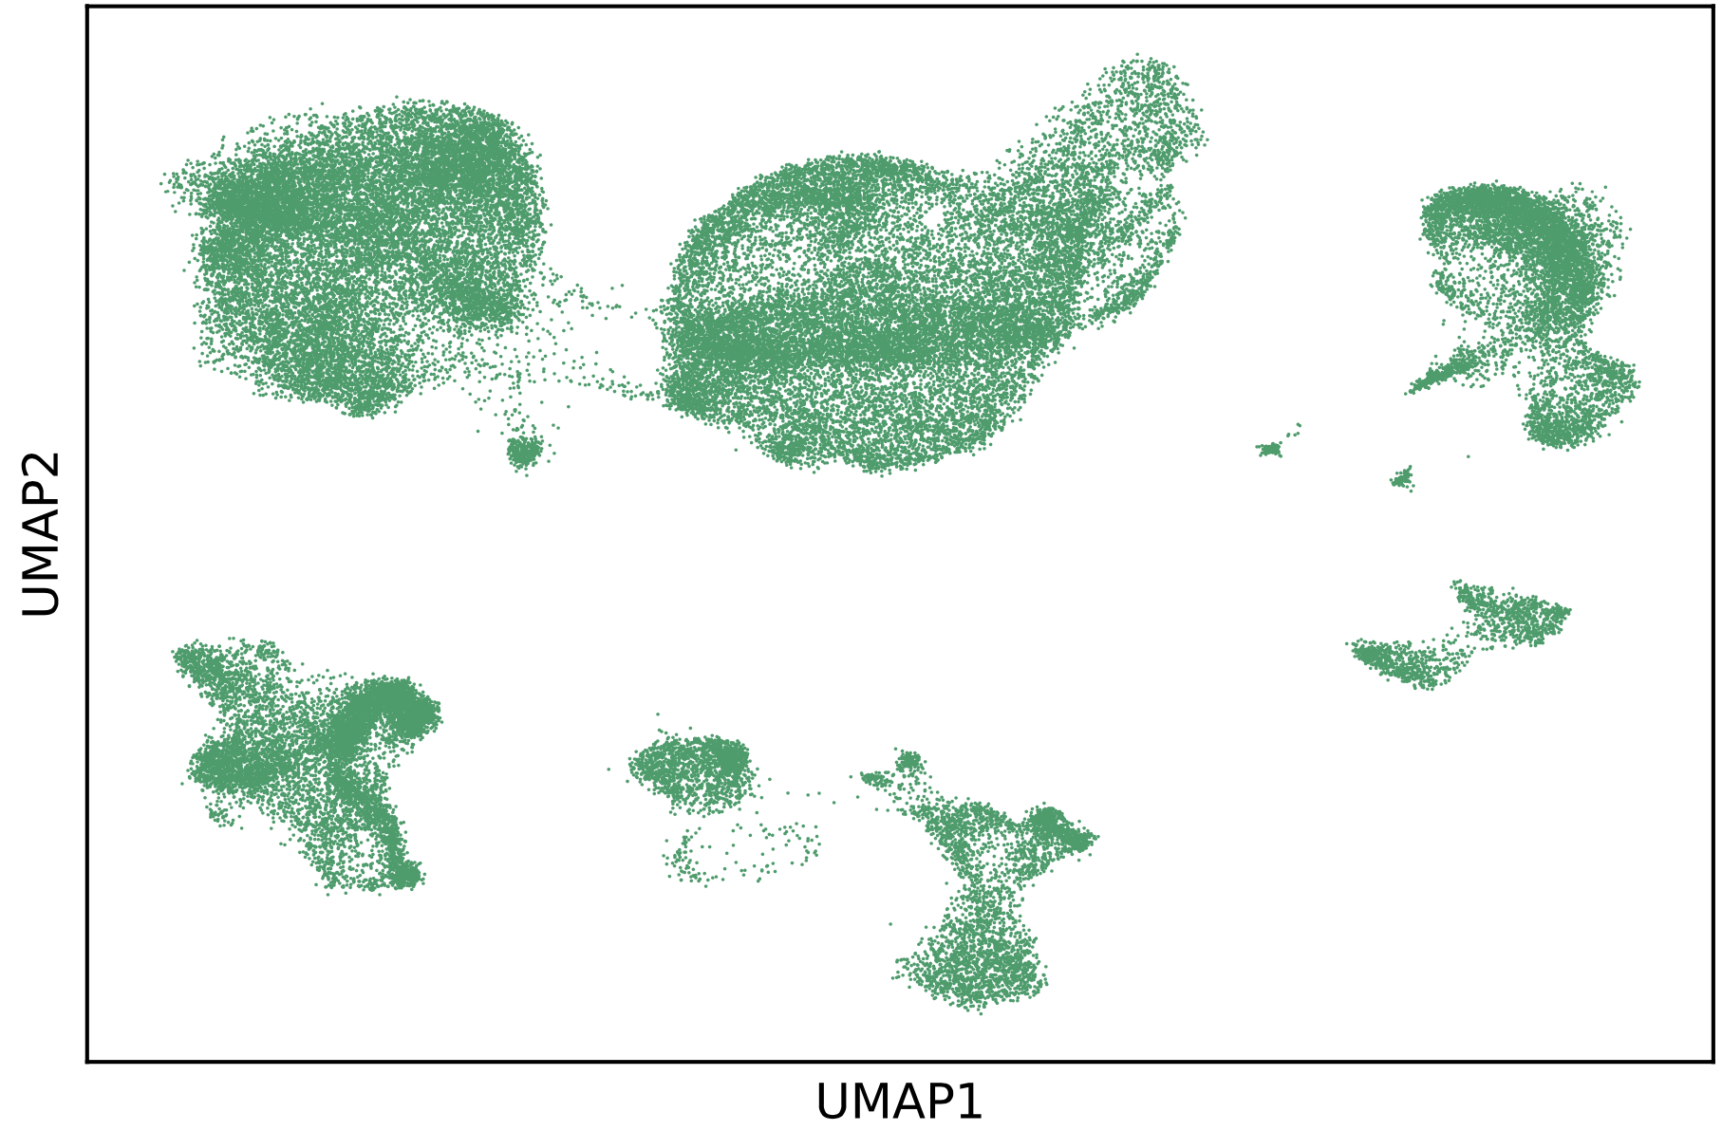
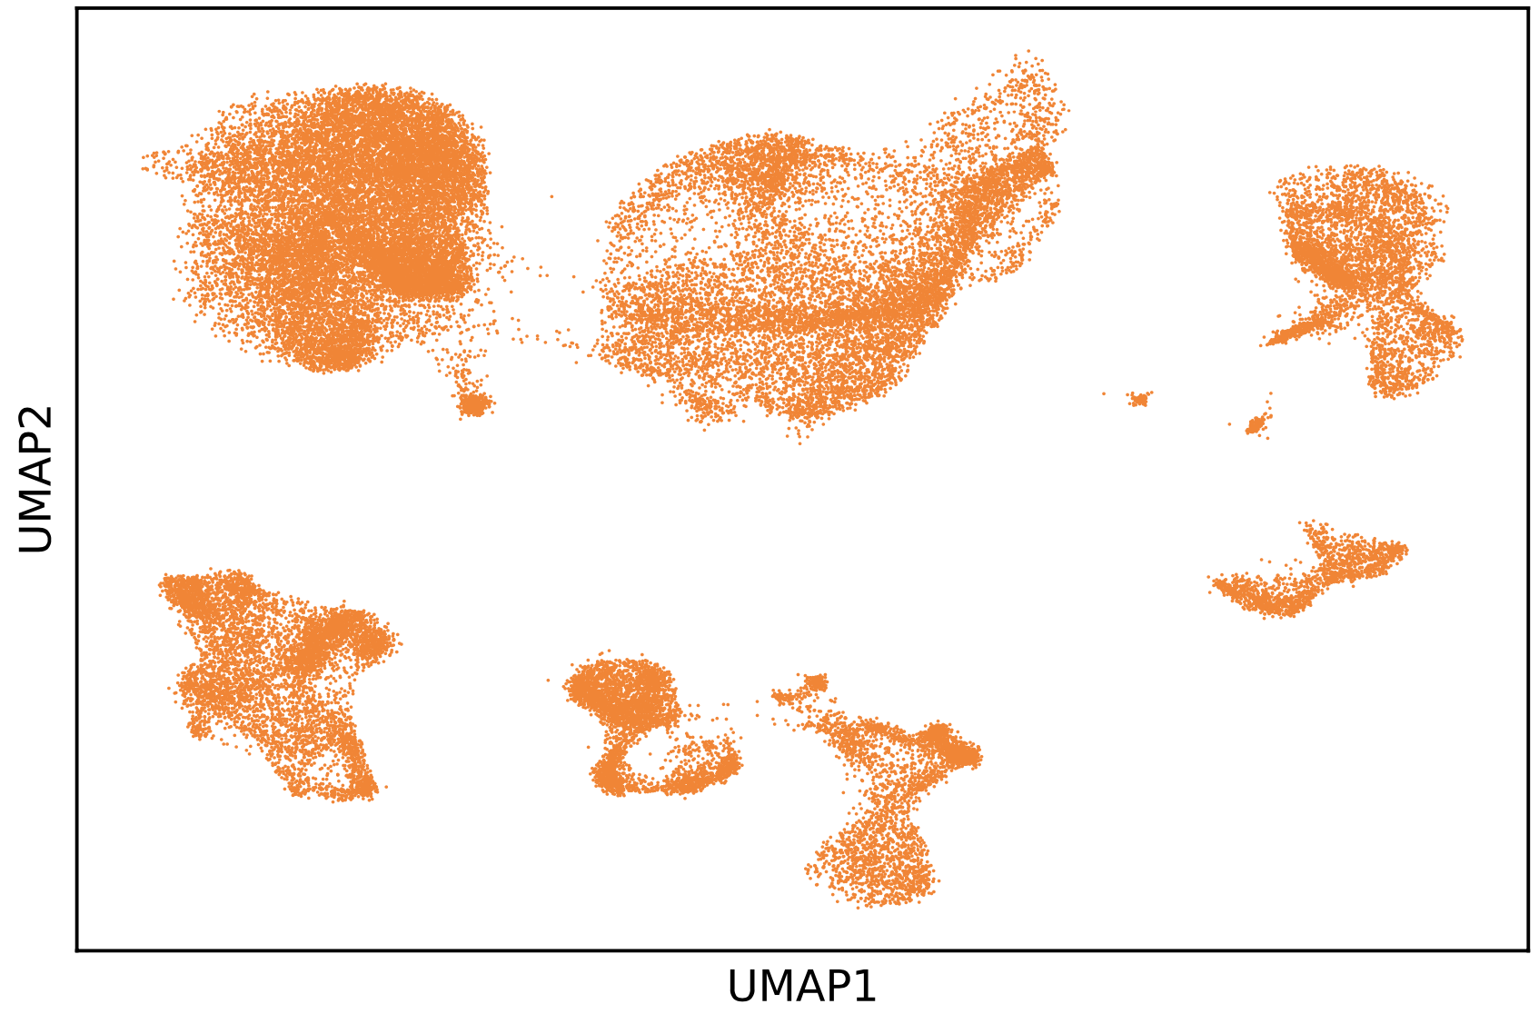
Which cell-types are affected by the condition?
Healthy
Non-Inflamed
Inflamed

Slide 8


Slide 9
Identifying cell types affected by biological conditions (RanForrest)
Assumption: for each cell type, if cells of two conditions are distinguishable, the accuracy of random forest classifier should be higher.
ACC = 0.5
ACC = 0.65
ACC = 0.9

Slide 10
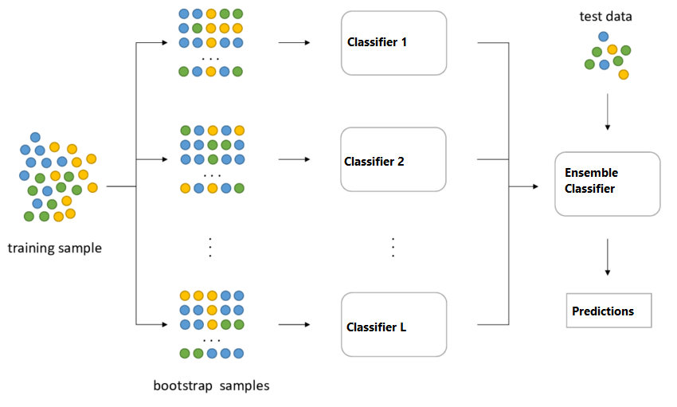
Random Forest Classifier

Slide 11
Cell type specific UMAP embedding supports RanForrest results
Healthy VS Inflamed
Parameters:
minimum number of cells in each conditions > 2000
Ratio between the number of cells in the two conditions should be higher than 0.6 and lower than 1.8
Accuracy
Cell types (dblabel)

Slide 12
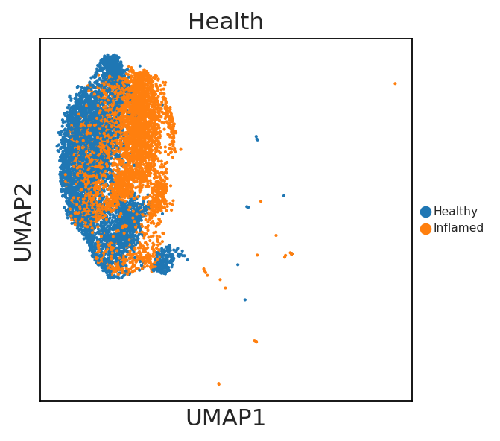
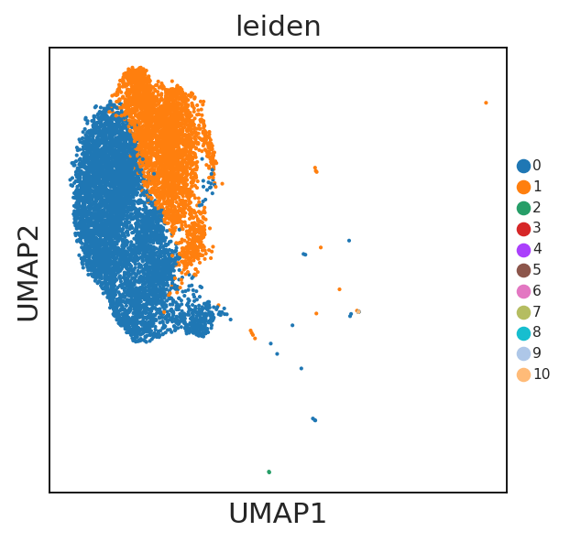
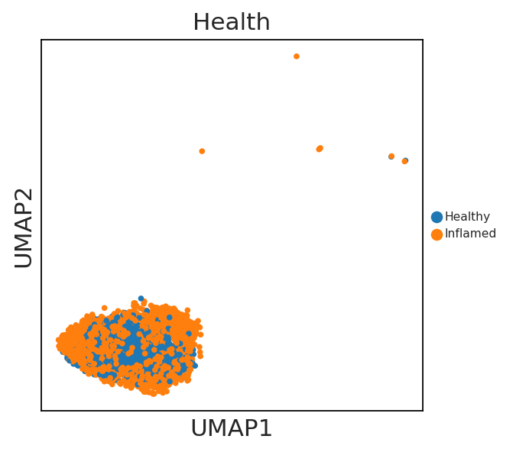
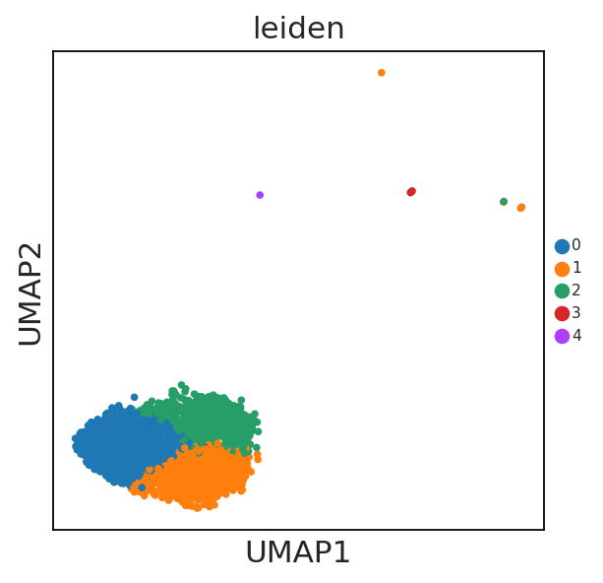
Cell type specific UMAP embedding supports RanForrest results
True labels
Clustering labels
Transient amplifying cells
ACC = 0.95
Activated CD4-positive, alpha-beta T cell
ACC = 0.65

Slide 13
What are the differential expressed genes in the top ranked cell types?
Transit amplifying cell
Normalized
Expression
Log2(UMI+ 1)
Proliferating transit amplifying cell
Normalized
Expression
Log2(UMI+ 1)
Enterocytes
Normalized
Expression
Log2(UMI+ 1)

Slide 14
What are the differential expressed genes in the top ranked cell types?
Transit amplifying cell
Proliferating
transit amplifying cell
Enterocytes
Normalized Expression Log2(UMI+ 1)
Normalized Expression Log2(UMI+ 1)
Normalized Expression Log2(UMI+ 1)

Slide 15

Future development of RanForrest
Use k-fold cross validation to reliably split data into training and testing datasets;
Work on better statistical differential expression analysis methods;
Explore the biological meaning of our findings;
RanForrest can support disease modeling, by identifying informative cell types of a disease.

Slide 16
Doing now what patients need next

Slide 17
transit amplifying
IF vs Healthy
NIF vs Healthy
t-test
wilcoxon

Slide 18
proliferating transit amplifying cell
IF vs Healthy
NIF vs Healthy
t-test
wilcoxon

Slide 19
enterocyte
IF vs Healthy
NIF vs Healthy
t-test
wilcoxon

